Slide 1

Movie Review Sentiment Analysis Using Natural Language Processing
Johnny Dryman

Slide 2
Goals
Use Natural Language Processing (NLP) with machine learning models to classify IMDB user reviews as ‘Positive’ or ‘Negative’
Understand how our model distinguishes between ‘Positive’ and ‘Negative’
Explore alternative scoring system for movies based on sentiment analysis

Slide 3
Data
Obtained 50,000 IMDB movie reviews
Reviews are labeled ‘positive’ or ‘negative,’ and are considered “highly polar” reviews
25,000 positive
25,000 negative
No associated movies or traditional 1-10 rankings were provided
Model targeted ‘positive’ or ‘negative’ sentiment

Slide 4
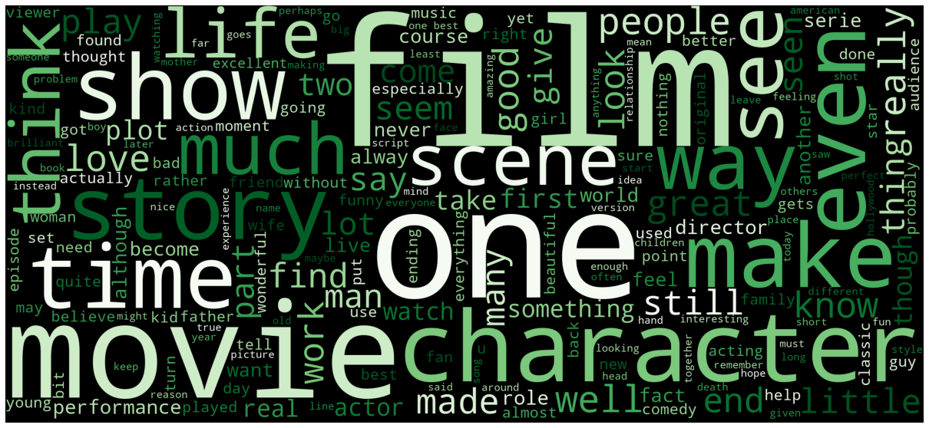
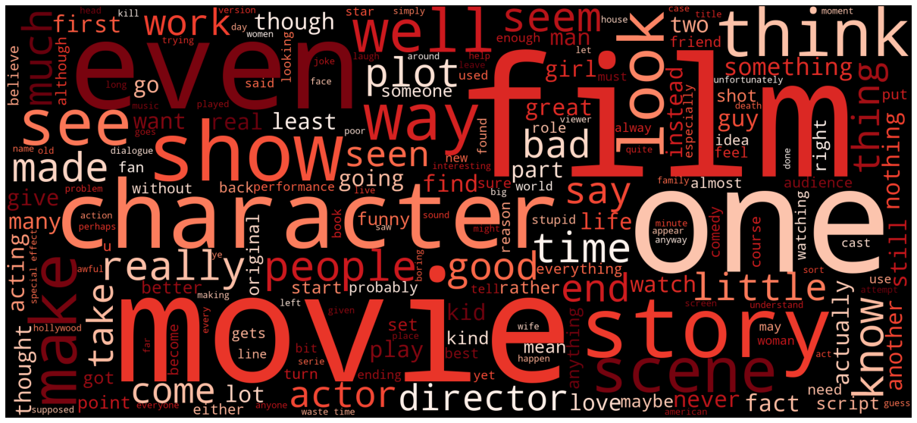
Word Clouds
Positive and Negative
Other than color palette, difficult to distinguish

Slide 5
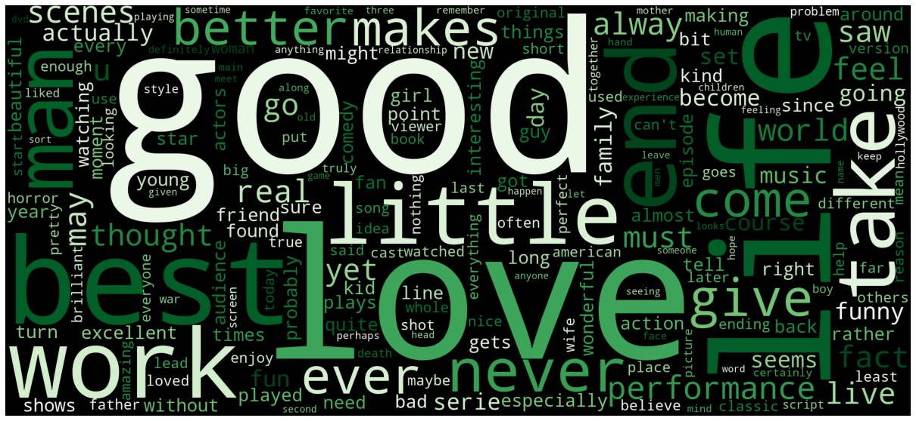
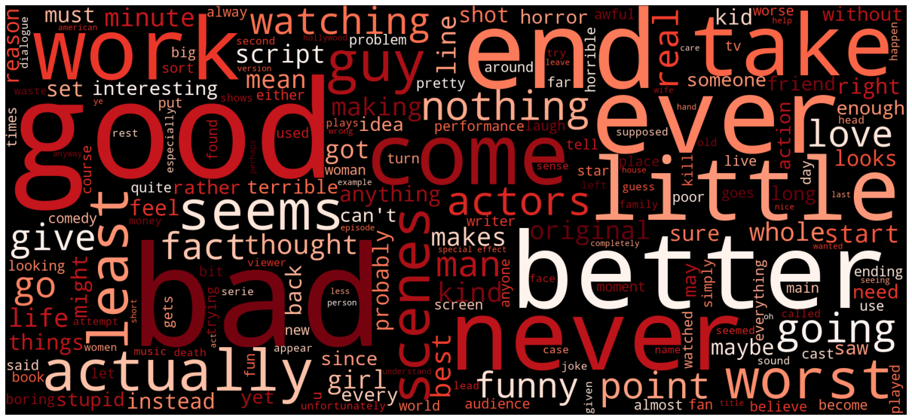
Word Clouds Pt. 2
Select frequent words removed
Positive and Negative
Much easier to distinguish
‘good’ is still a significant word in both positive and negative reviews, would be interesting to confirm what word comes before ‘good’ (i.e. ‘not good’)

Slide 6
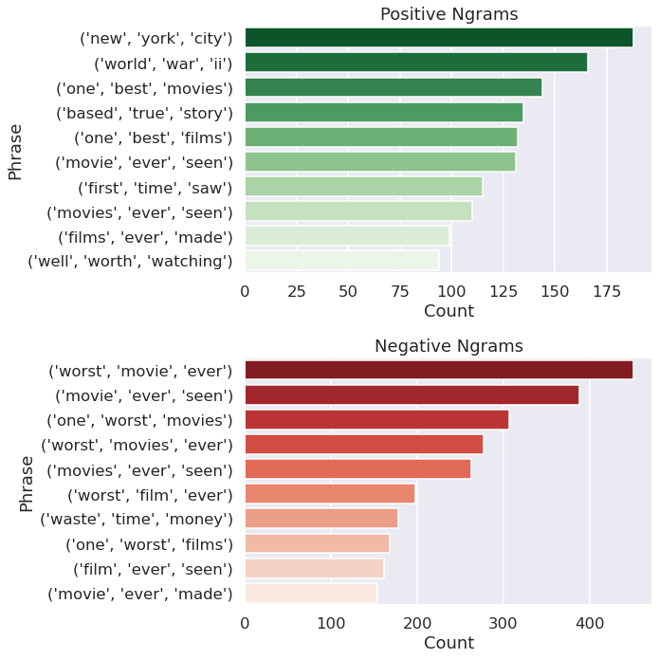
Trigrams
Positive and Negative
Collection of three words that appear most commonly
Generally superlative
“One best movies”
“Worst film ever”
Notes:
Add title or Y label specify which was positive and which was negative. Change title.

Slide 7
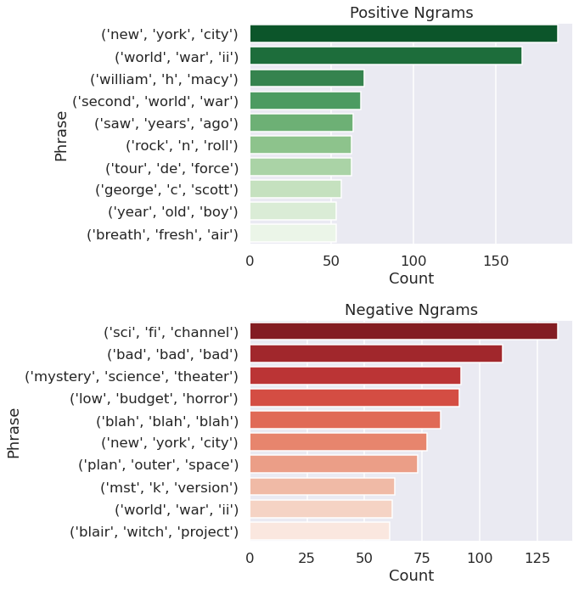
Trigrams Pt. 2
Positive and Negative
Same list of words removed from Word Clouds
Results speak to unique skew of review dataset
“William H Macy”
“Mystery Science Theater”
Notes:
Add title or Y label specify which was positive and which was negative. Change title.

Slide 8
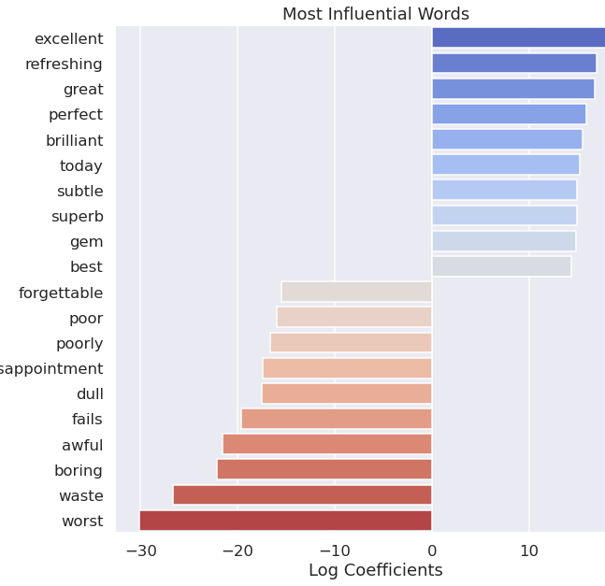
Best Model: Linear Regression
Model Accuracy: 89.51%
Coefficients:
Positive and Negative
Words that influenced towards or away from classifying a review as ‘positive’
Mostly strong positive or strong negative adjectives
Notes:
Add title to graph. Positive negative influential words.

Slide 9
Conclusions
Model depended on overtly positive or overtly negative adjectives
Review sentiment can be reasonably predicted with an accuracy of 89.5%

Slide 10
Recommendations
Use ‘positive’ and ‘negative’ sentiment model to calculate new score for all movies in database
Compile a new list of top 250 movies
Compare user scored top 250 with top 250 as calculated by sentiment analysis
Depending on results, release to public

Slide 11
Next Steps
Experiment with different tokenizers, stop word lists, stemming, and lemmatization
Reviews were added to dataset based on “highly polar” nature, quantify or qualify what this means
Compile new dataset with buckets for multiclassification
Score of 1-3 / 10 = Negative
Score of 4-6 / 10 = Neutral
Score of 7-10 / 10 = Positive
Explore alternative machine learning models
Support vector machines
K nearest neighbors
Deep learning / neural network models

Slide 12
Thanks for your time!
Please feel free to ask any questions.

